Slide 1
Segmentation for 3D printing
Attila Nagy
University of Szeged
Csaba Pintér
EBATINCA, S.L., Spain
38&40th NA-MIC Project Week, 2023 January – 2024 January

Slide 2
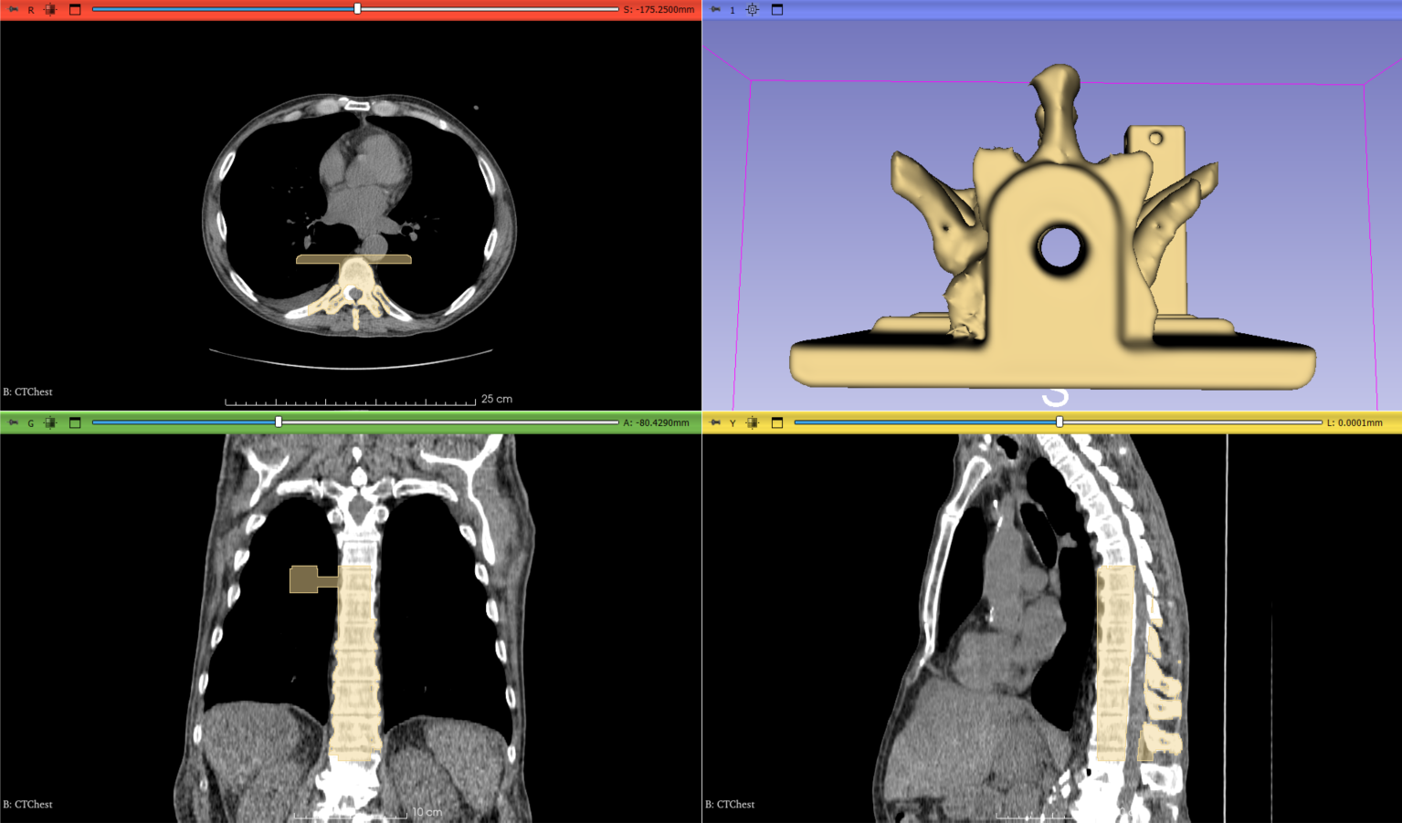
Learning Objective
This tutorial demonstrates image segmentation in the Segment Editor module of 3D Slicer for the purpose of 3D printing.

Slide 3
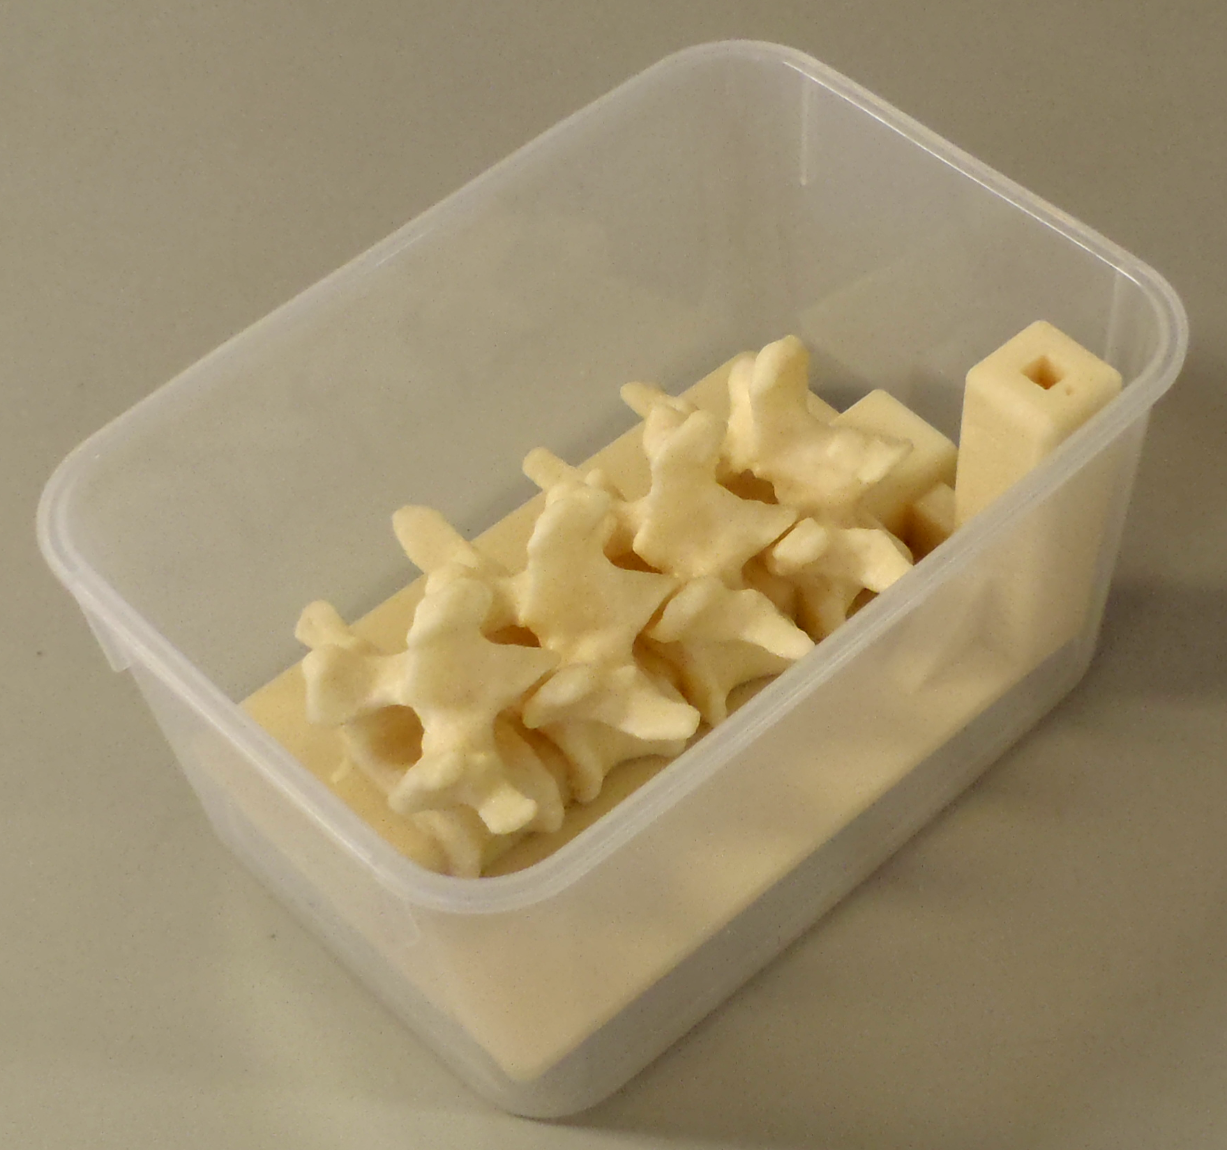
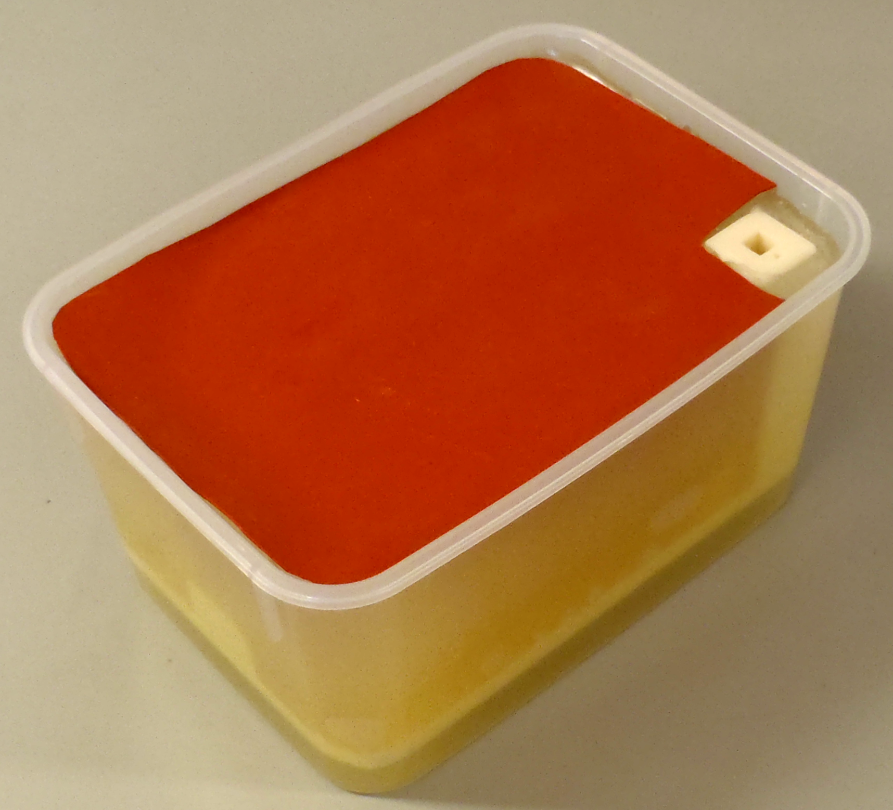
Clinical utility of the created spine phantom
Training phantom for needle insertion
Electromagnetic marker holder
Filled with gel (~soft-tissue)
Covered with sheet (~skin)
Tube with water in the center
Moult et al. 2013

Slide 4
Material
This tutorial requires the installation of a recent 3D Slicer stable release (at least 5.6.1), which is available at the
Slicer download page:
http://download.slicer.org/
Tutorial dataset: Phantom base STL model
https://raw.githubusercontent.com/Slicer/SlicerSegmentationFor3DPrintingTutorial/main/BasePiece.stl (source: PerkLab Model Catalog)
User documentation pages:
https://slicer.readthedocs.io/en/latest/user_guide/modules/segmentations.html
https://slicer.readthedocs.io/en/latest/user_guide/modules/segmenteditor.html

Slide 5




Platforms
Developed and maintained on Windows 64bit, macOS, and Linux 64bit & 32bit
Slicer requires
Minimum 4GB RAM (more is recommended)
Dedicated GPU for fast rendering (OpenGL 3.2+)

Slide 6

A quick guide on how to use this tutorial
Slicer is a comprehensive platform. Hence, there’s usually more than one ways to work with your data and achieve the same result.
During the course of this tutorial, we sometimes show more than one possibility, so you will see three kinds of slides:
Slides that are common to both approaches, have a white background.
If you are interested in somewhat more details, then simply follow all the slides. Slides with a light green tint show different ways to achieve the same results.
If you want a quicker solution, without going too much into the details, in addition to the white ones, follow the slides marked with a clock (shown in the corner), and a slighty red-tinted background.

Slide 7
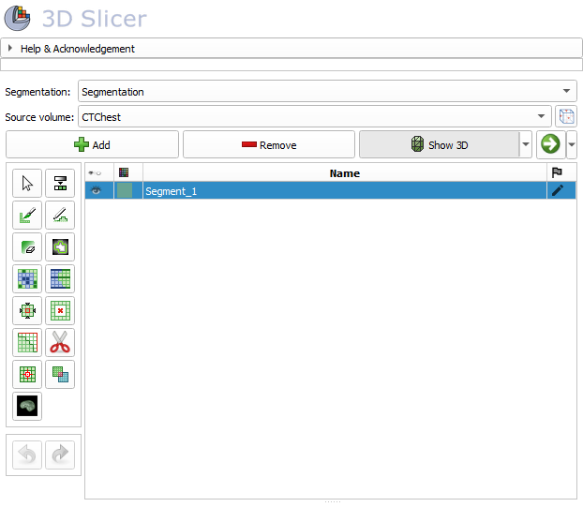
Segment Editor module
Real-time 3D surface update
Editing on oblique slices
Overlapping segments
Intuitive tools
Manual
Semi-automatic
Advanced settings

Slide 8
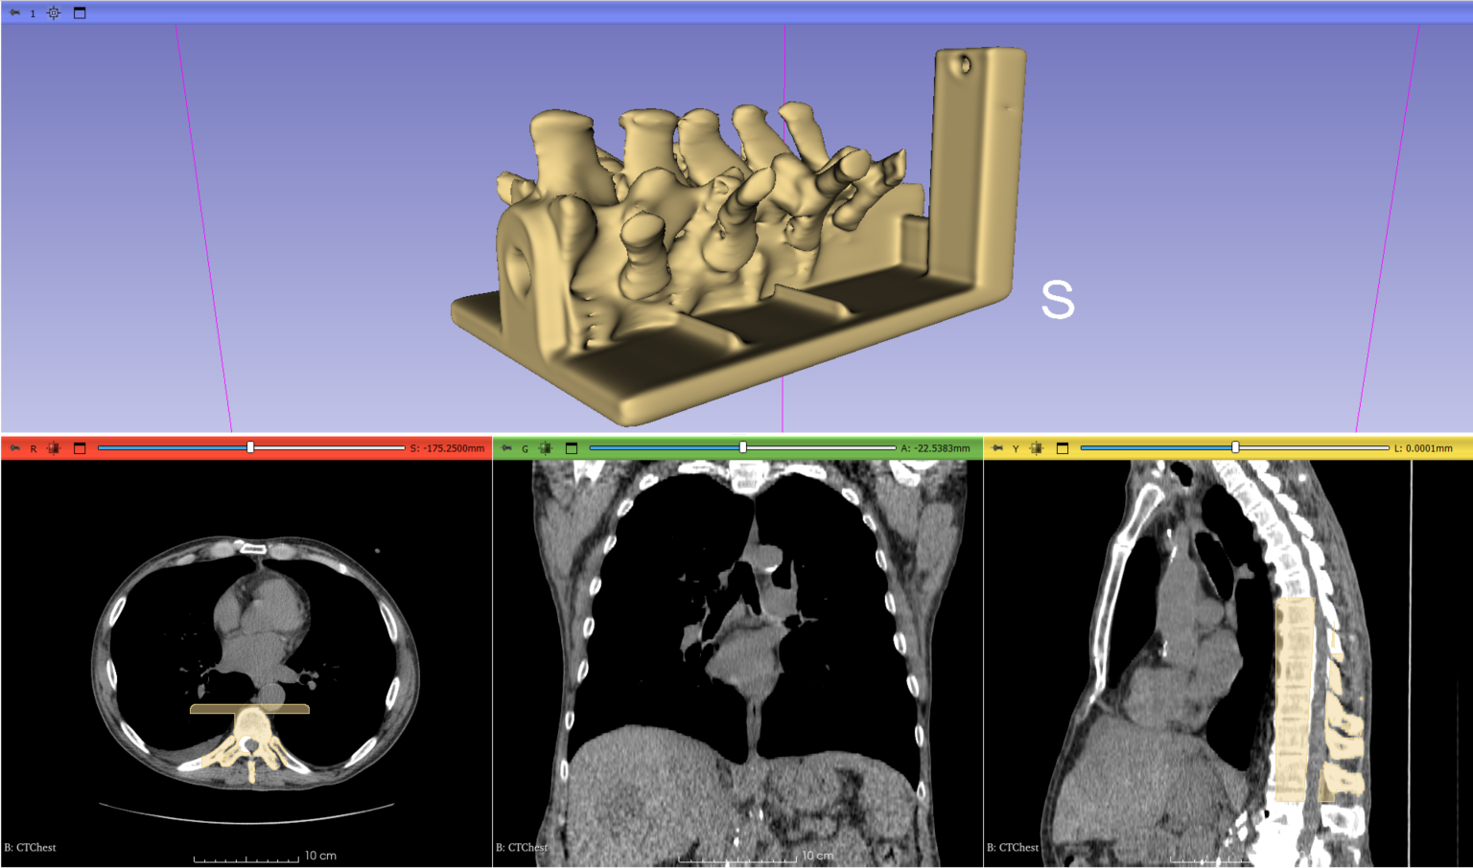
Overview
Load CT image
Segment vertebrae to be 3D printed
Add phantom base to segmentation
Merge and finalize phantom
Save phantom segment to STL file for 3D printing

Slide 9
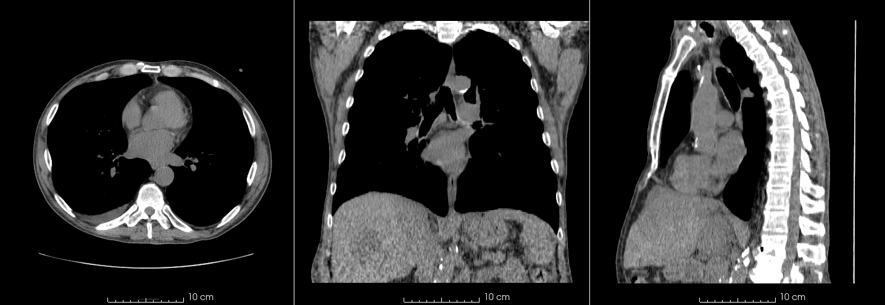
Part 1: Load CT image
Overview:
Load sample “CTChest” dataset
Set image contrast for better visibility

Slide 10
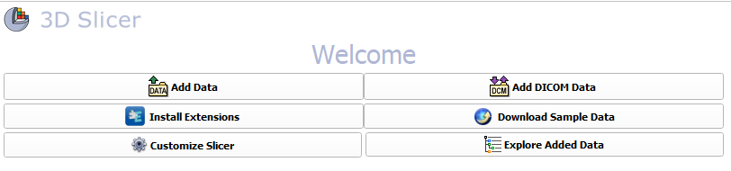
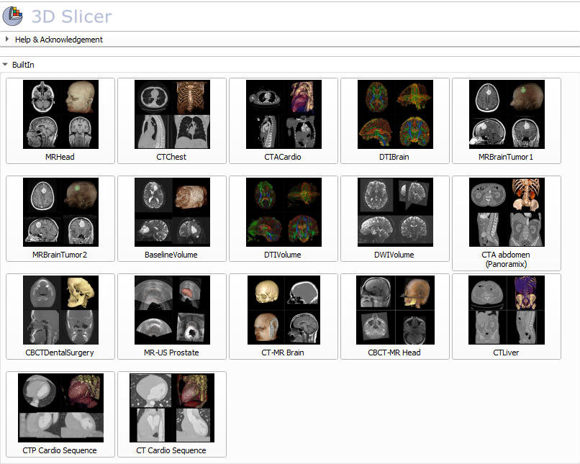

1/1: Load CTChest dataset

Slide 11
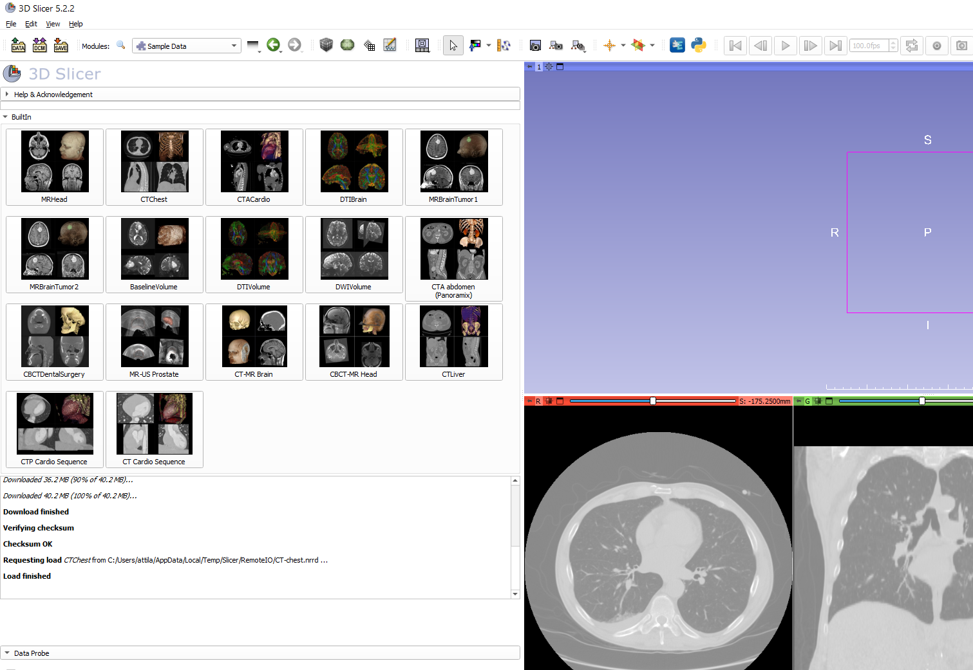
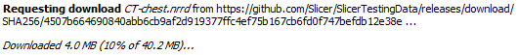
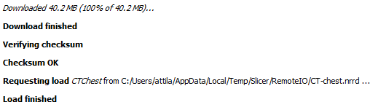
1/2: Sample CT loaded
.
.
.

Slide 12
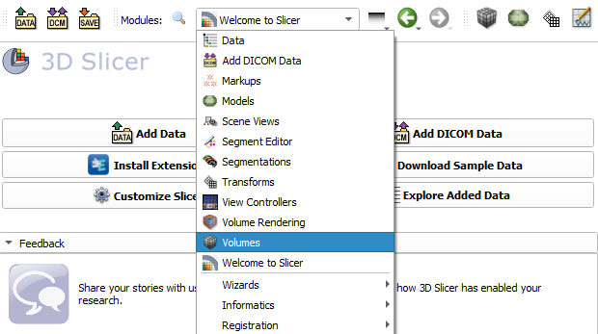
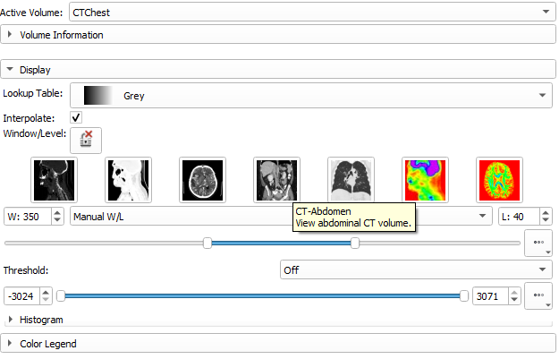
1/3/A: Change contrast
Select CTChest as active volume and click on the preset

Slide 13
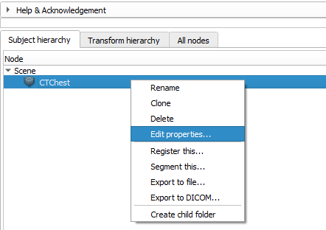
1/3/B: Change contrast
Switch to the Data module
Select CTChest as active volume and click on the preset
Right-click on the data and click Edit properties…

Slide 14
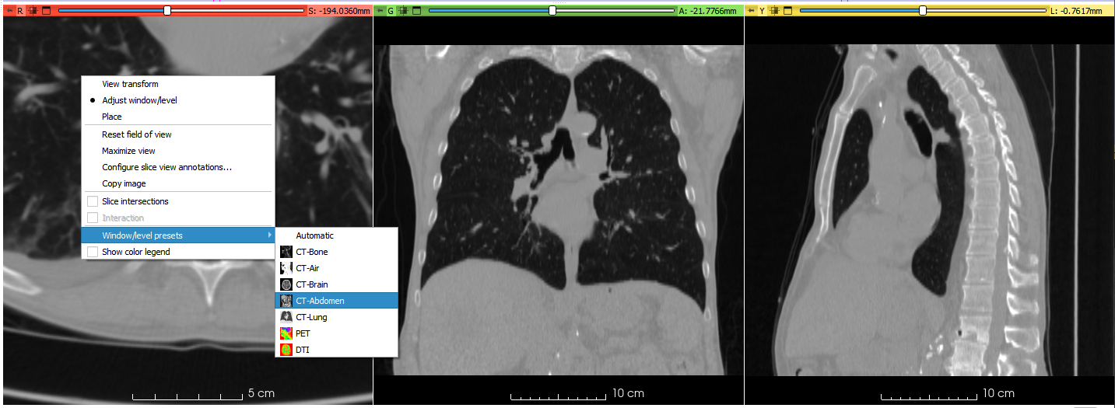
1/3/C: Change contrast
Right-click on any of the slice views, select Window/Level presets, and select CT-Abdomen

Slide 15
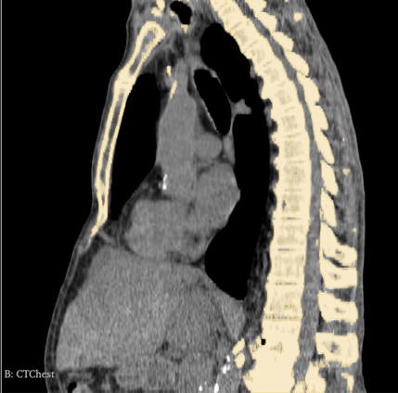
Part 2: Segment vertebrae
Overview:
Add new segment
Threshold bone
Remove speckles with Islands
Cut out vertebrae with Scissors

Slide 16
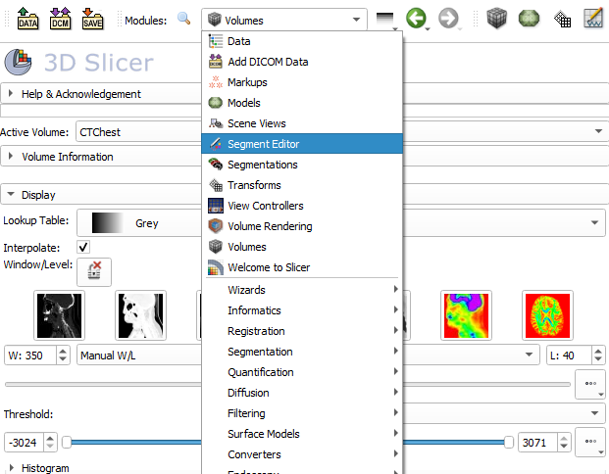
2/1: Switch to Segment Editor module

Slide 17
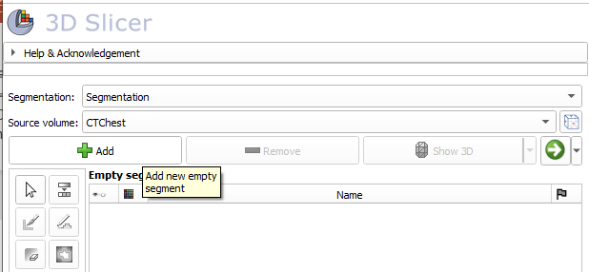
2/2: Add new segment
- Segmentation automatically created
- CT volume automatically selected as source
(Source volume is the segmented volume that defines the resolution of the segments)

Slide 18
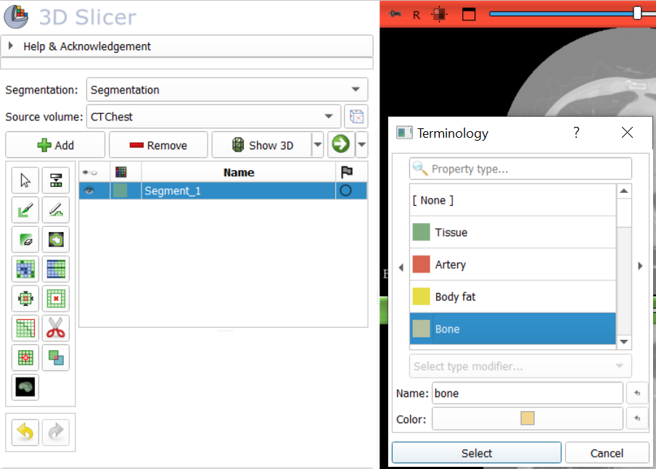
2/3: Set terminology
1. Double-click on the segment’s color
2. Pick a Terminology for the given segment (A name and a color for the segment.)
You can also set a different name and color if needed.
It is not required, but makes your workflow more robust.

Slide 19
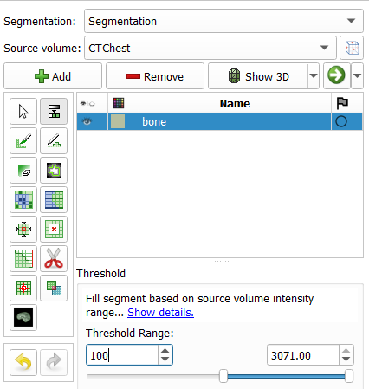
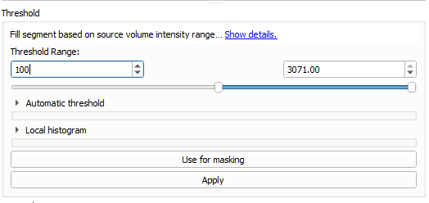
2/4: Set threshold to get bone
Set 100

Slide 20
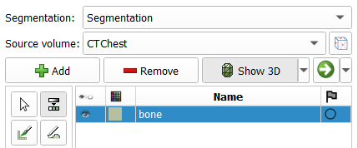
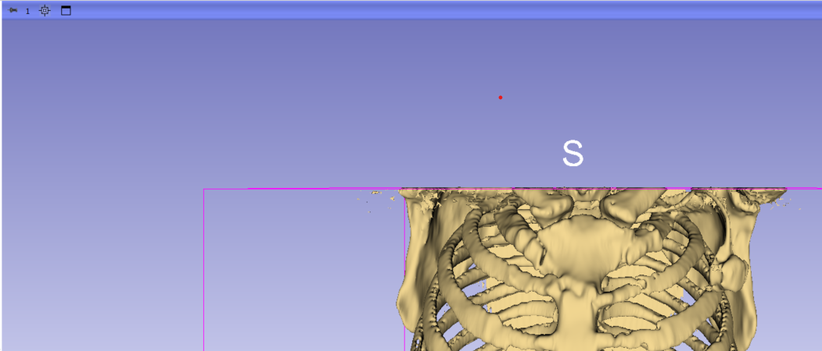
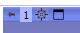
See it in 3D!
Center the 3D view

Slide 21
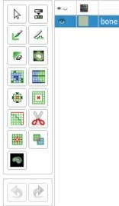
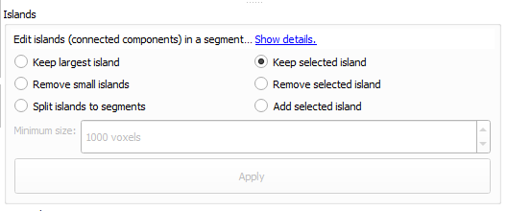
2/5: Remove speckle with the Islands effect
Select the Islands effect

Slide 22
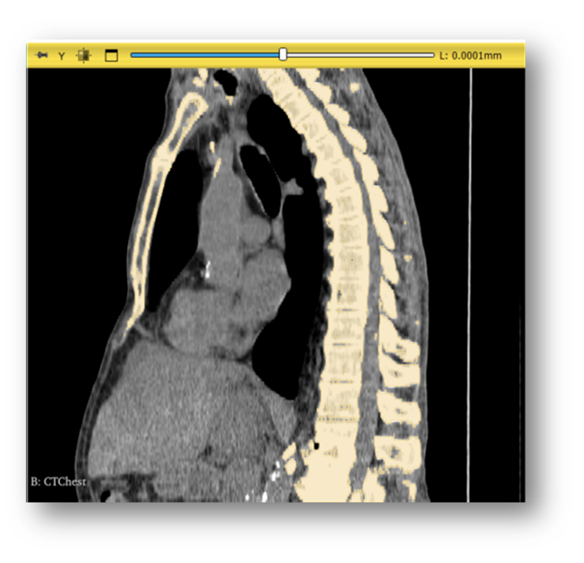
2/5: Remove speckle with the Islands effect
Click on the spine

Slide 23
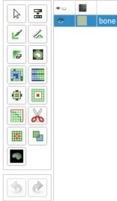
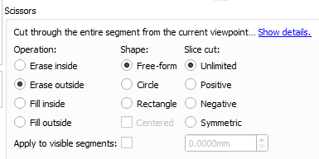
2/6: Cut out vertebrae with Scissors
1. Select the Scissors effect
2. Choose Erase outside as operation
3. Choose Free-form shape

Slide 24
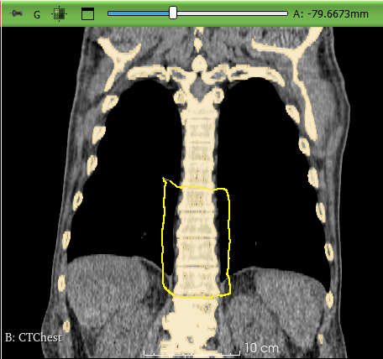
2/7: Cut out vertebrae with Scissors
Trace around the desired vertebrae with the scissor on the coronal view (green slice)

Slide 25
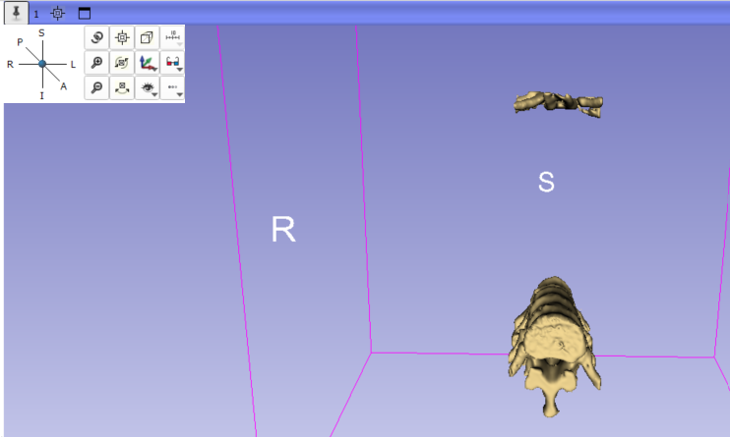
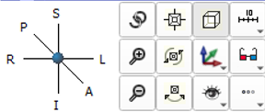
Orient the 3D view
No need to click, just hover your mouse over the pin icon
Click „S” to view from superior

Slide 26
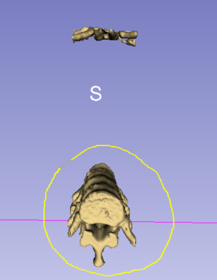
2/8: Remove remaining parts with Scissors
Select the vertebrae in the 3D view to erase the unnecessary parts (ribs on the anterior side in this case)

Slide 27
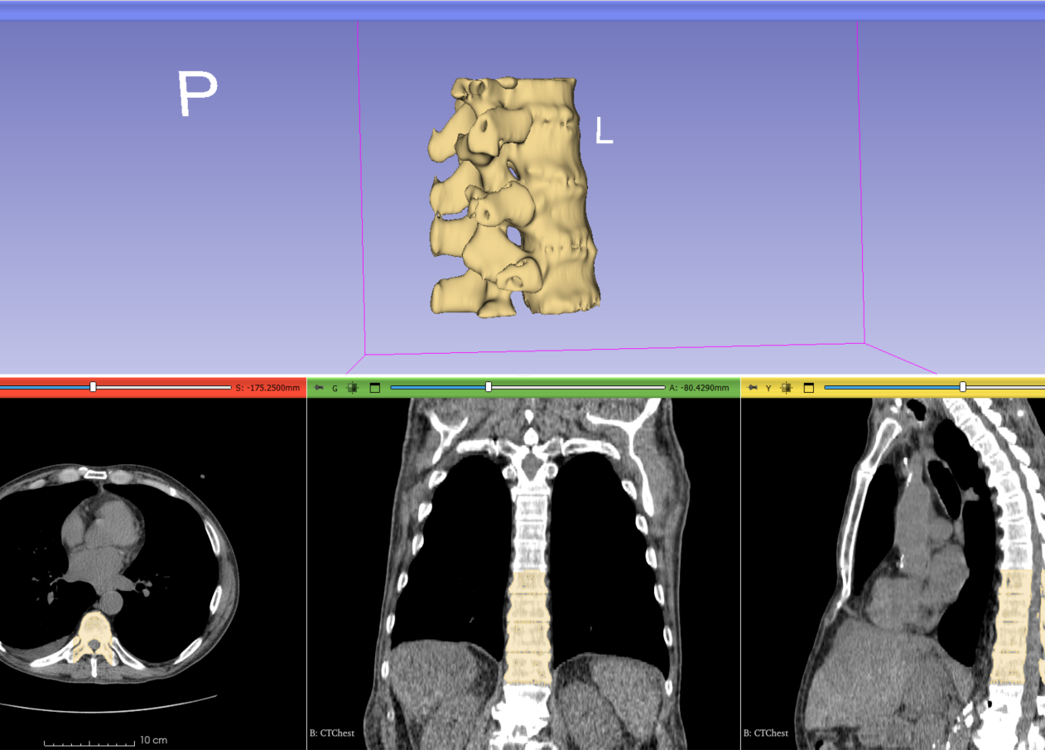
2/9: Vertebrae are segmented

Slide 28
Part 3: Add phantom base
Overview:
Load phantom base STL file
Transform model to desired position and orientation
Import model to segmentation node
Cut hole through middle of the spine

Slide 29
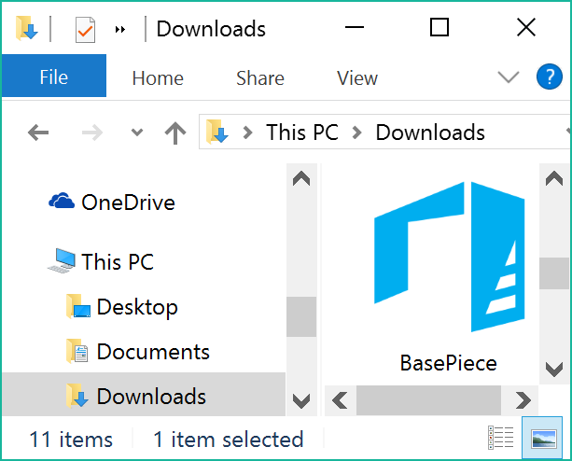
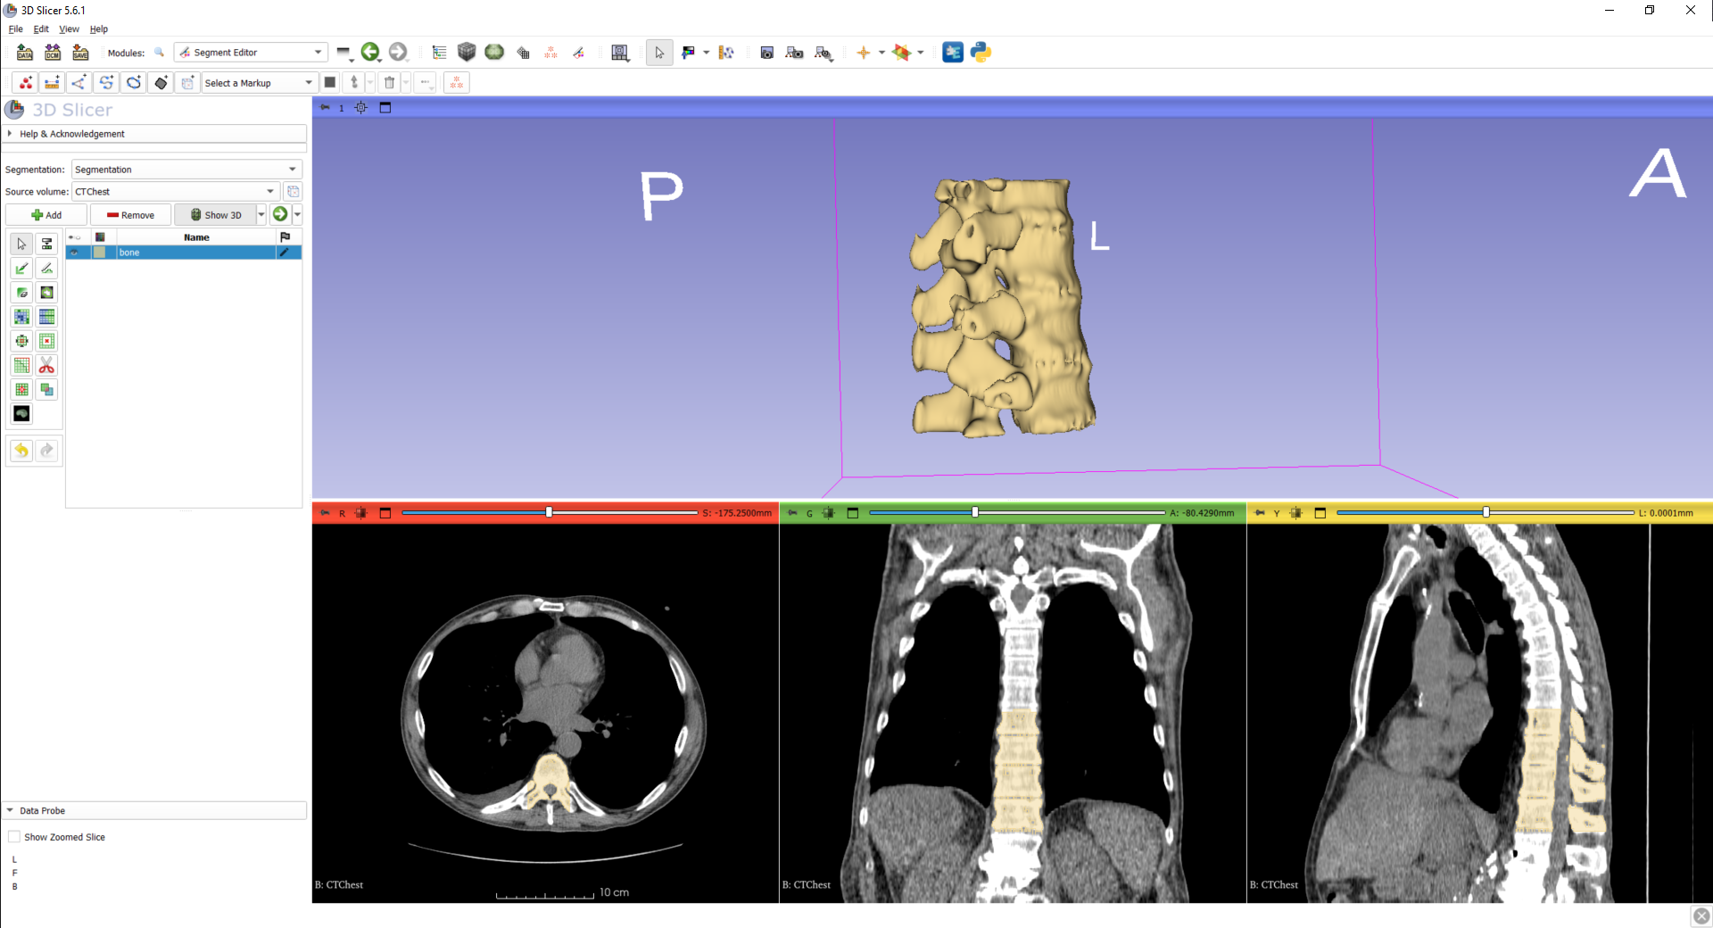
3/1: Load phantom base as model node
Download phantom base STL file from https://www.slicer.org/wiki/File:BasePiece.zip
Extract the contents of the zip file and drag&drop BasePiece.stl onto the Slicer window

Slide 30
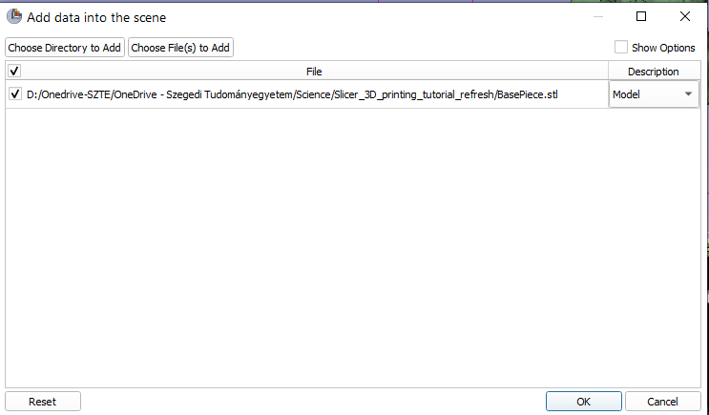
3/2: Load phantom base as model node

Slide 31
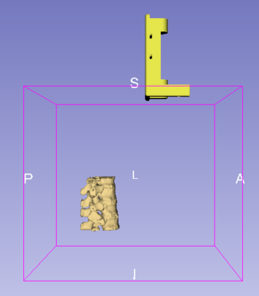
3/2: Load phantom base as model node
Phantom base is loaded

Slide 32
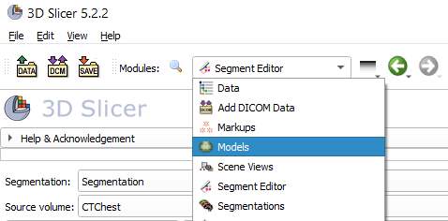
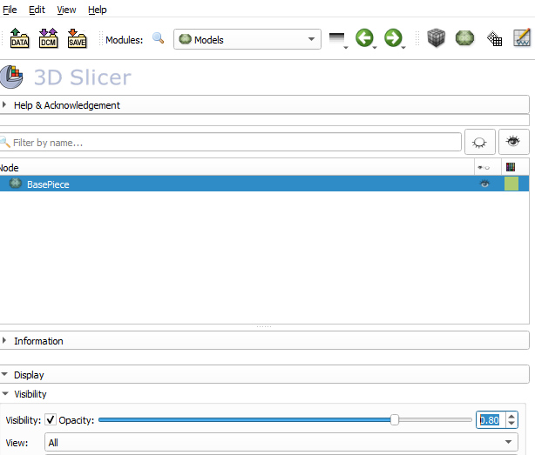
3/1: Make base semi-transparent in Models
1. Switch to Models module
2. Decrease opacity to 0.8
When both the segmentation and the model are opaque, it is hard to see when they are in a good relative position

Slide 33
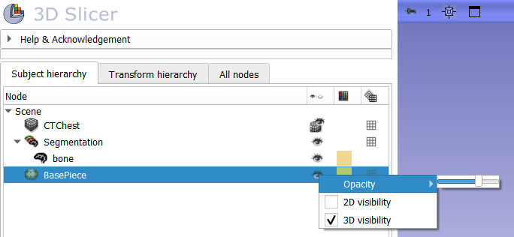
3/1: Make base semi-transparent
Switch to the Data module
Right-click on the eye icon next to BasePiece, and hover your pointer over the Opacity option. Set it to about 3/4.
When both the segmentation and the model are opaque, it is hard to see when they are in a good relative position

Slide 34
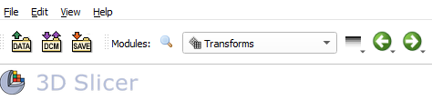
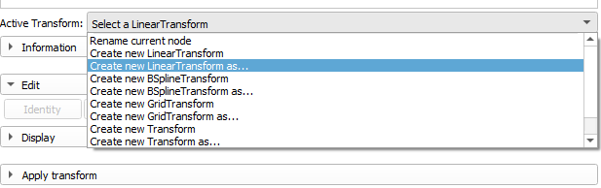
3/2/A: Create transform
1. Switch to the Transforms module
2. Create linear transform 3. Name it ‘BaseToSpineTransform’

Slide 35
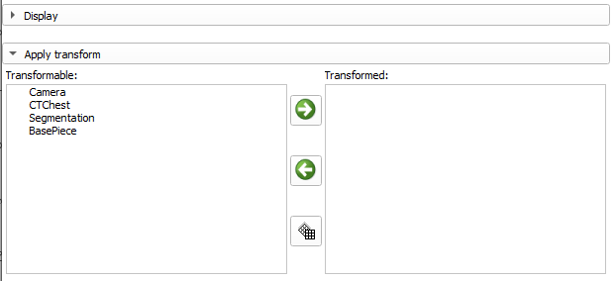
3/3/A: Apply transform to base
1. Select base piece
2. Move it under the transform

Slide 36
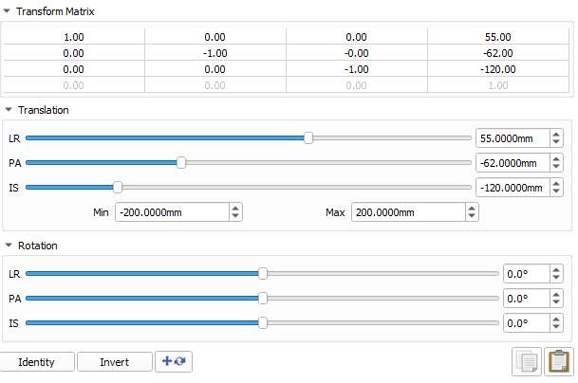
3/4/A: Move base into place
1. First rotate the model 180 degrees Left-Right by dragging the „LR” slider to the left
2. Move sliders until the base is in the correct position (values in picture are the final ones)

Slide 37
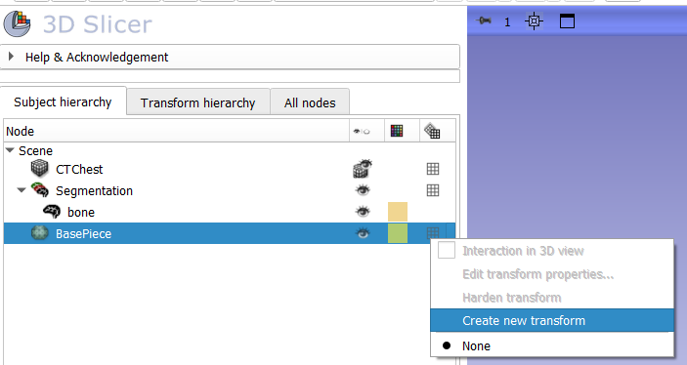
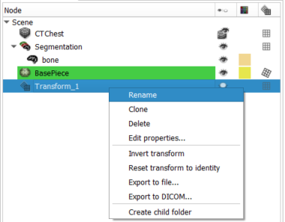
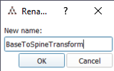
3/2/B: Create transform
1. Right-click on the grid (the last icon)
2. Create linear transform
3. The transform will appear in the list 4. Right-click on it and rename it ‘BaseToSpineTransform’
1
2
4

Slide 38
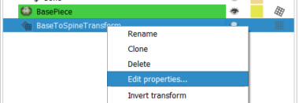
3/4/B: Move base into place
1. First rotate the model 180 degrees Left-Right by dragging the „LR” slider to the left
2. Move sliders until the base is in the correct position (values in picture are the final ones)
(We don’t need 3/3 when we do it this way)
Right-click the transform again, and choose Edit properties…

Slide 39
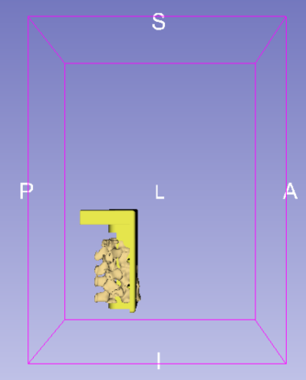
3/6/A: Base is in the correct position

Slide 40


3/6/B: Base is in the correct position
But we need to remove some slack

Slide 41


3/7: Use Scissors effect to remove slack
1. Switch back to Segment Editor
2. Erase slack

Slide 42
Part 4: Merge and finalize phantom
Overview:
Create segmentation from base piece
Copy base piece segment into vertebrae segmentation
Merge two segments
Cut hole through phantom

Slide 43


4/1: Import base into segmentation

Slide 44


4/1/A Import base into segmentation
Switch to the Data module, right click on Basepiece, and select „Convert model to segmentation node”
Drag and drop „Basepiece” from the „Basepiece segmentation” to below the „ Bone” segment.

Slide 45

4/2: Merge the two in Segment Editor
Back to Segment Editor
2
Select Logical operators
Select spine (bone)
Choose Add operation
Select BasePiece
Click Apply
1
3
5
4

Slide 46

4/3: Remove base piece segment
2
1

Slide 47

4/3: Remove base piece segment
Switch to the Data module
Right-click the BasePiece segment node and choose Delete

Slide 48


4/4: Cut hole through phantom using Scissors

Slide 49

4/4: Cut hole through phantom using Scissors
You can also cut the hole from within the 3D view.

Slide 50

Phantom is ready!

Slide 51
Part 5: Save phantom to STL
Overview:
Export phantom segment to model node
Save model to STL file

Slide 52

5/1: Export phantom segment into model
Switch to the Segmentations module
1
Select the segment
Select Export
Select Models
Choose Export models to new folder
Click Export
2
3
4
5

Slide 53


5/2: Save model into STL

Slide 54

5/1: Export phantom segment into model
Switch to the Data module, right-click on the segment, and click Export visible segments to models
You can set the visibility of a segment by clicking the eye icon

Slide 55




5/2: Save model into STL
Still in the Data module, right-click on the segment, and choose Export to file
Set the output directory by clicking on the 3 dots.
Click Export format drop-down and select ‘.stl’
Click Export

Slide 56
Conclusion
In the tutorial we summarized through an example, how we can load, and segment an anatomical region in 3D Slicer, and also, what steps it takes to prepare the created model for 3D printing.

Slide 57






Acknowledgements
National Alliance for Medical Image Computing
NIH U54EB005149
Ontario Consortium for Adaptive Interventions in Radiation Oncology
Cancer Care Ontario
PerkLab, Queen’s University, Kingston, Ontario, Canada
University of Szeged, Szeged, Hungary
Ebatinca S.L. Las Palmas de Gran Canaria, Gran Canaria, Spain

